Slide 1
Cease
Hardware assisted companion app to aid cigarette smokers in quitting
Abhijit Pranam
Joshua (Jihang) Lim
Ken Dong
Notes:
Animated for the start

Slide 2

15%
of adults currently smoke in the United States
https://www.cdc.gov/tobacco/data_statistics/fact_sheets/adult_data/cig_smoking/index.htm
Notes:
In 2015, about 15 of every 100 U.S. adults aged 18 years or older (15.1%) currently smoked cigarettes. This means an estimated 36.5 million adults in the United States currently smoke cigarettes.
More than 16 million Americans live with a smoking-related disease.

Slide 3

13%
of young adults (aged 18-24) are active smokers
https://www.cdc.gov/tobacco/data_statistics/fact_sheets/adult_data/cig_smoking/index.htm

Slide 4
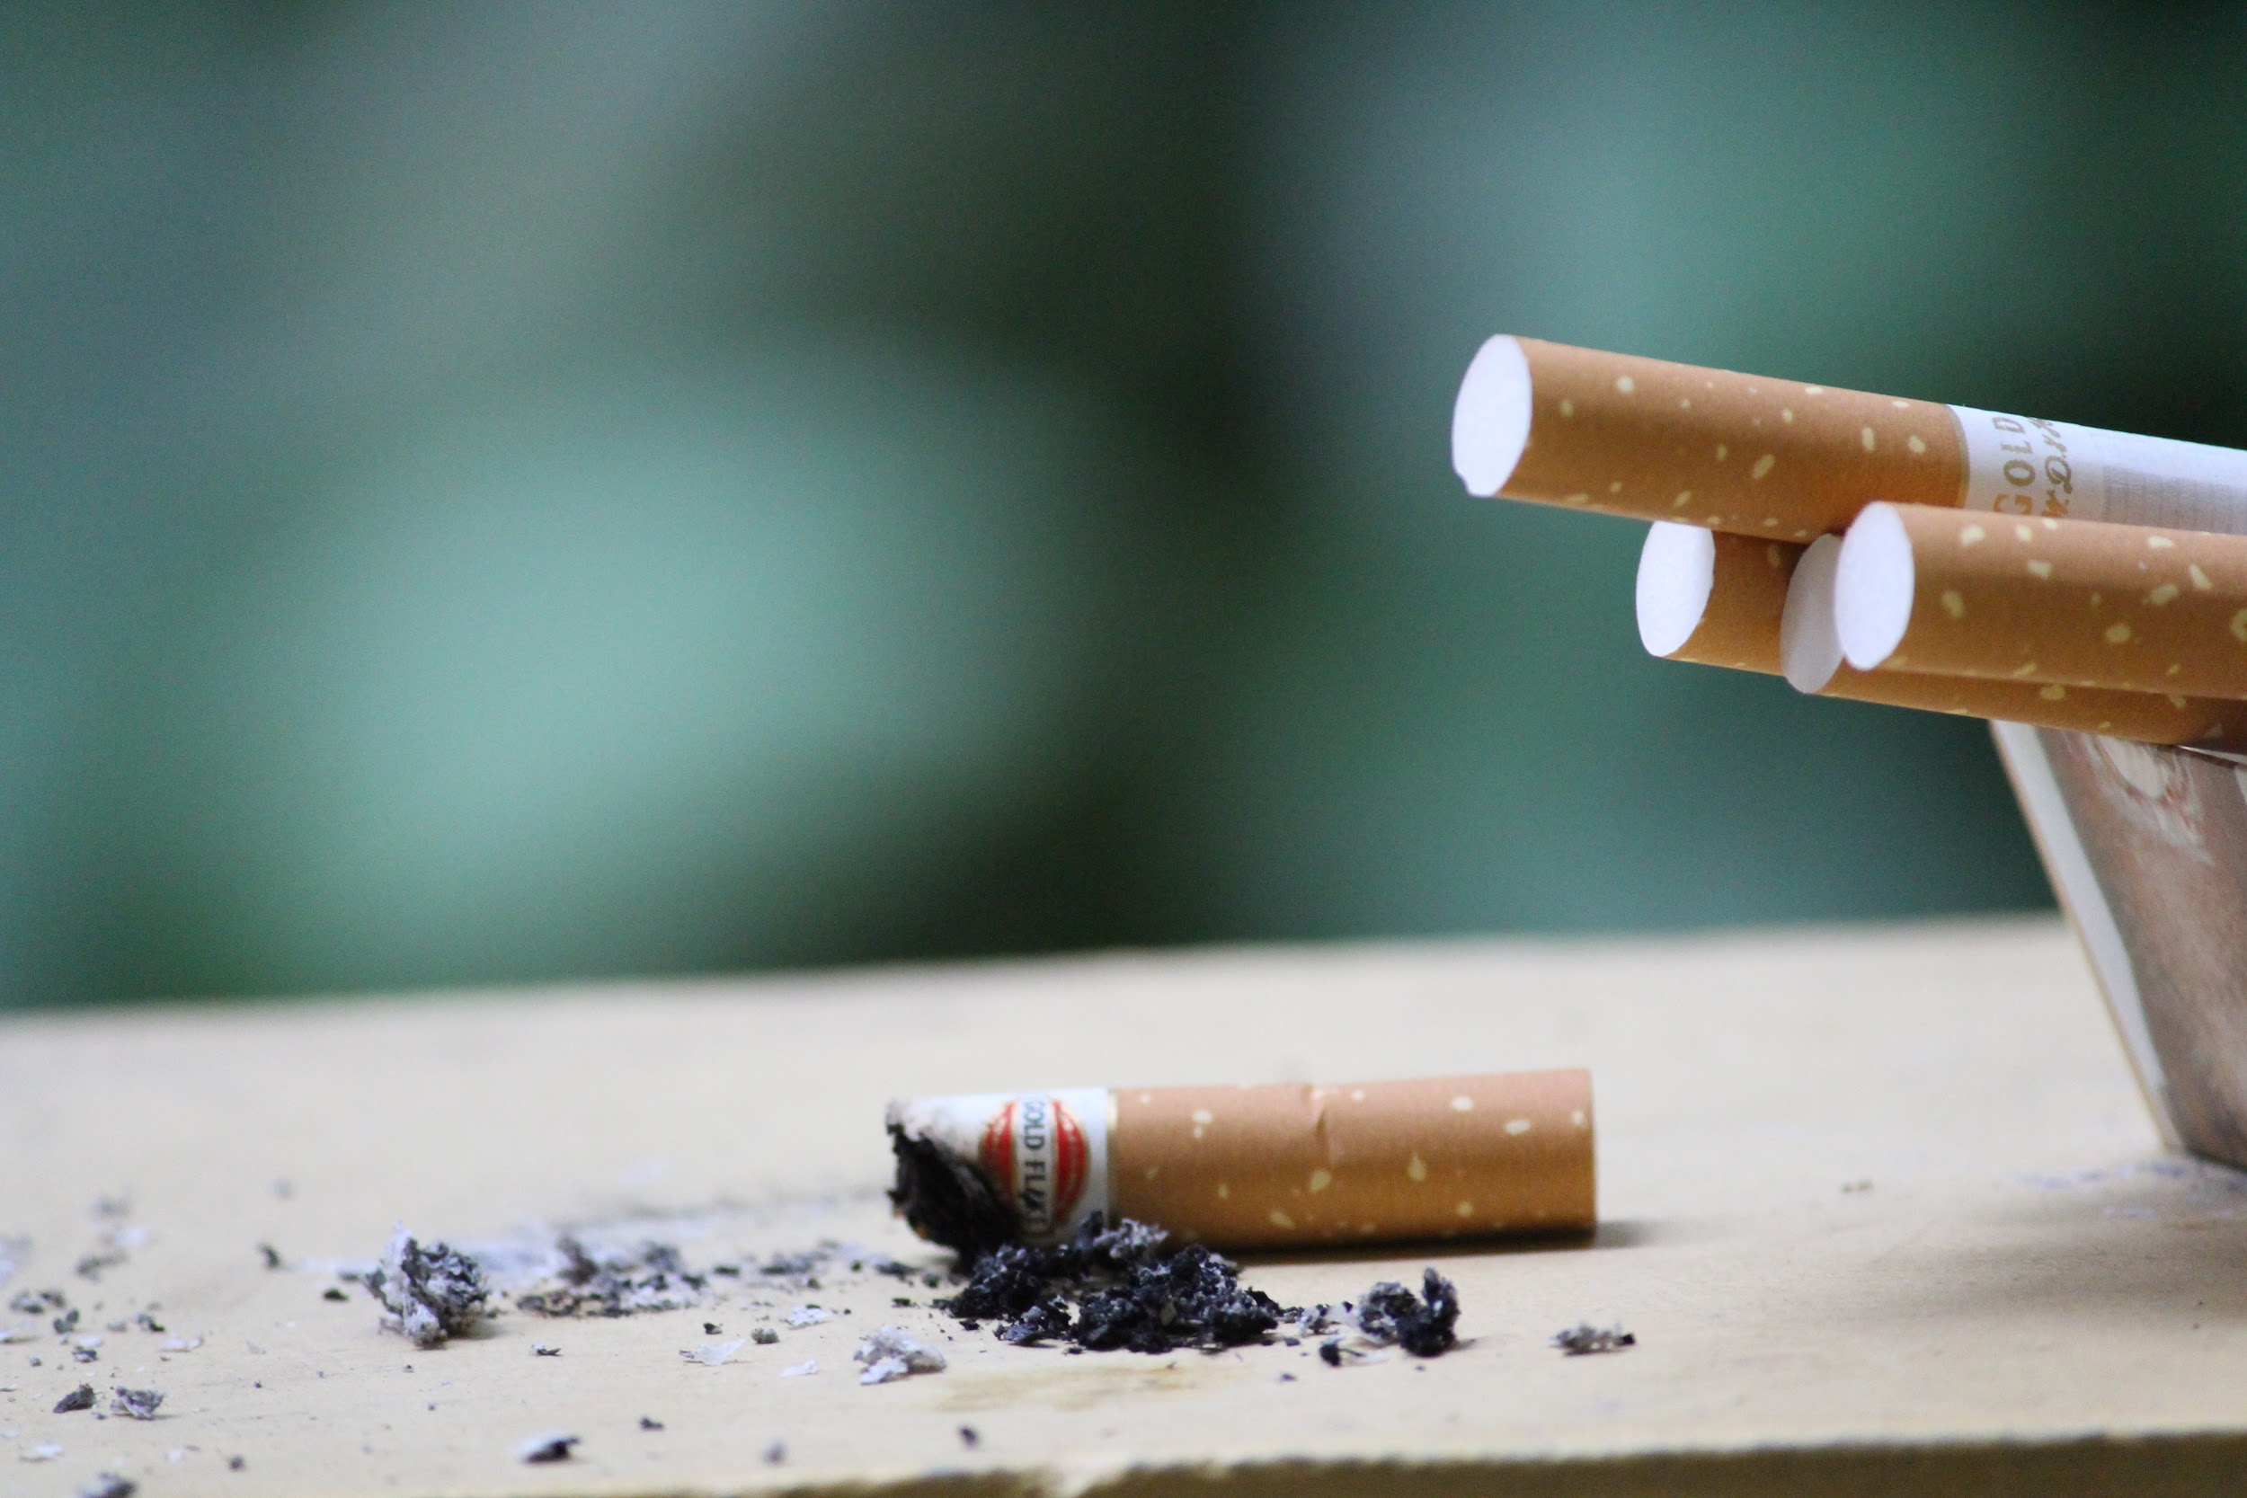
70%
of smokers want to quit
http://www.statisticbrain.com/quitting-smoking-statistics/
Notes:
7% of quitters will succeed at quitting smoking on their first try
3.5% of quitters will succeed at quitting smoking cold turkey

Slide 5
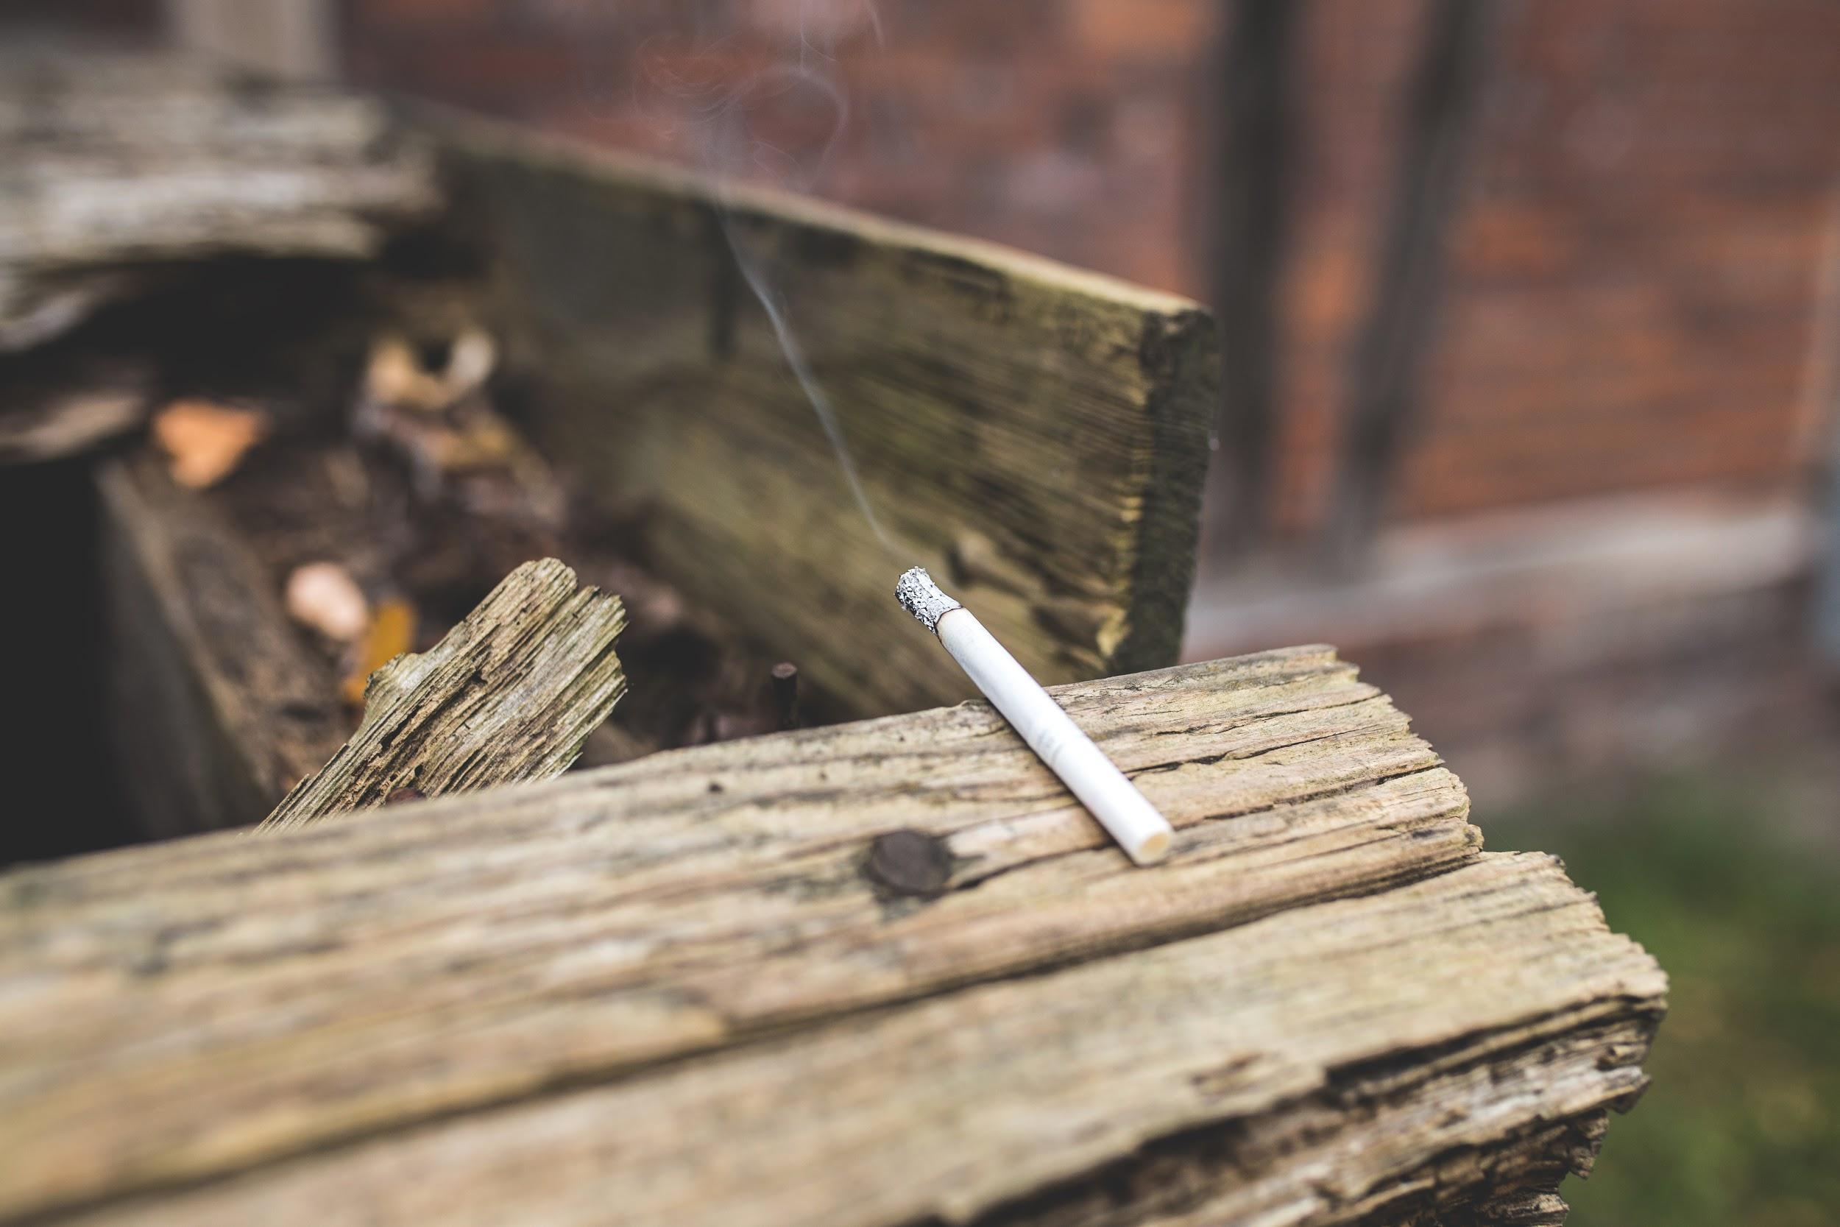
20%
of deaths every year are from smoking
https://www.cdc.gov/tobacco/data_statistics/fact_sheets/adult_data/cig_smoking/index.htm

Slide 6
Overall Problem
Smoking cessation methods are often tedious
Smokers who rely on willpower for smoking cessation often fail
Tobacco use is the leading preventable cause of death in the U.S.
https://www.cdc.gov/tobacco/data_statistics/fact_sheets/adult_data/cig_smoking/index.htm

Slide 7
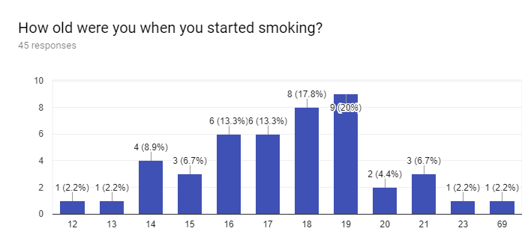
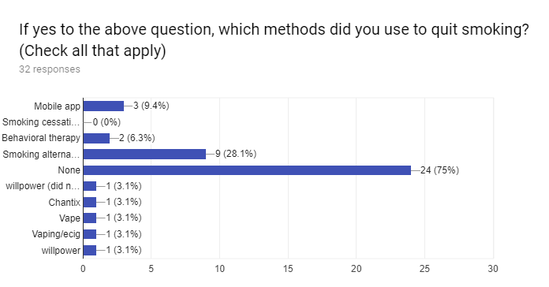
Design Research
Questionnaires powered by Google Survey.
Detailed information from one-on-one interviews.
Notes:
Animated to separate at first (5 clicks for themes)

Slide 8
Design Research
Themes
Displeasure towards self-reporting
Social influence
Familiarity with electronic cigarette products
Willpower as main quitting method
Questionnaires powered by Google Survey.
Detailed information from one-on-one interviews.
Notes:
Animated to separate at first (5 clicks for themes)

Slide 9






Tasks
Nicotine/Tar Tracking
Quitting
Buddies
Analyzing
Triggers
Smoking
Alternatives
Quantifying
Cost
Locating
Clinics

Slide 10

Design Sketches
Smart Filter with Companion Application
Smart Lighter with Companion Application
Social Buddy Mobile Application

Slide 11
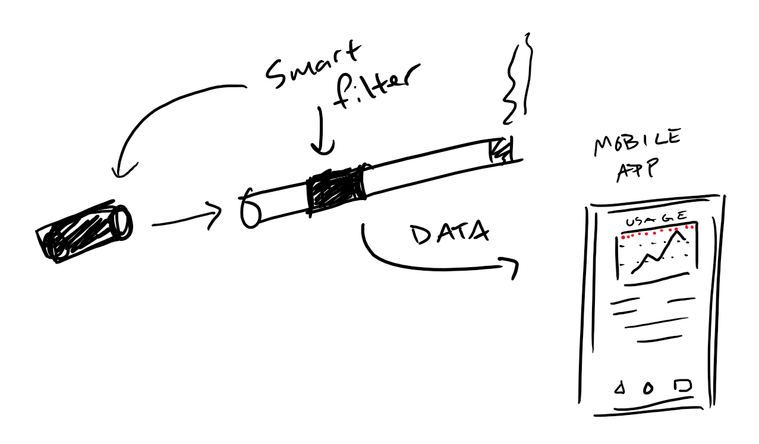
Smart Filter with Companion Application

Slide 12
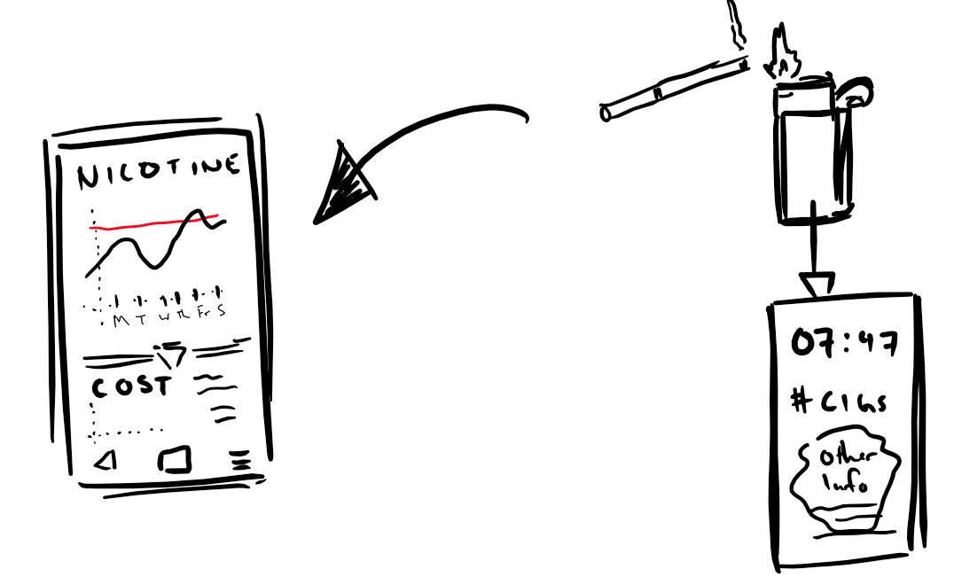
Smart Lighter with Companion Application

Slide 13
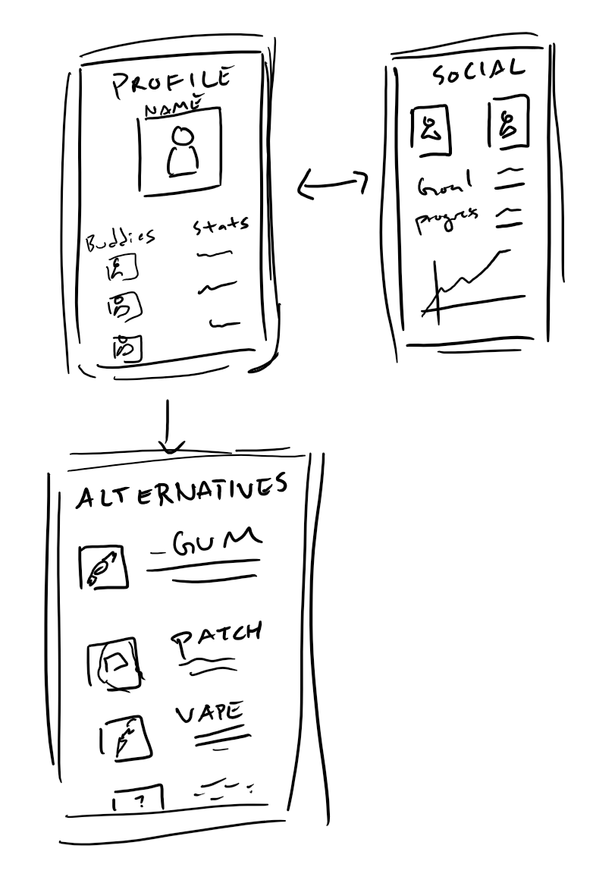
Social Buddy Mobile Application

Slide 14
Selected Design:
Smart filter with a companion app

Slide 15
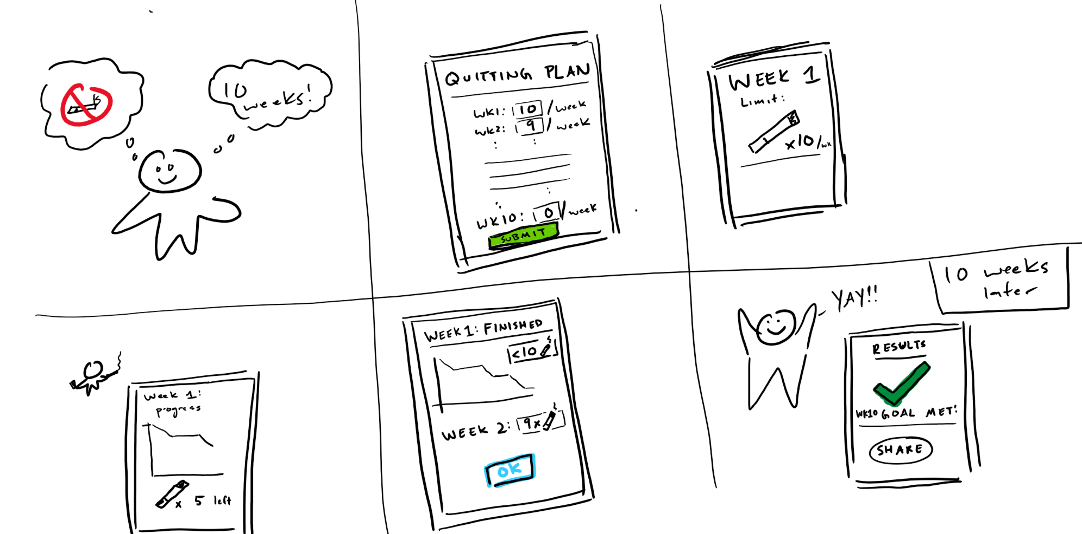
Scenario 1: John uses a weekly plan to reduce his smoking intake

Slide 16
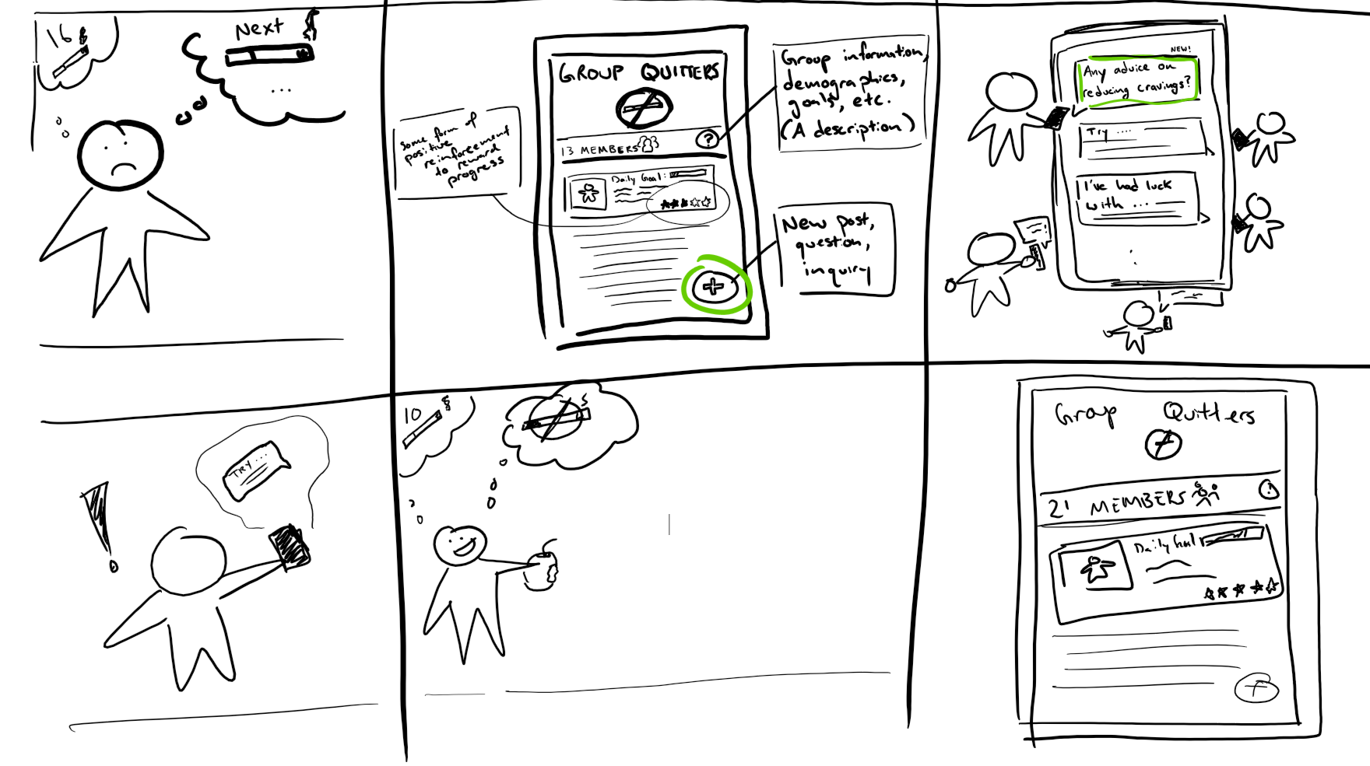
Scenario 2: Randy seeks support from a social community to help him quit smoking

Slide 17
Summary
Minimize self-reporting
Develop social foundation
Innovate for ease of use
Design to motivate

Slide 18
Cease
Any questions?

